Slide 1
Smart Inventory Management System
Module 1: Authentication & Authorization
Intern Name: Anvitha Boppana

Slide 2
Problem Statement
Many organizations face difficulties in managing inventory due to manual and outdated tracking methods. These practices result in inaccurate stock records, delayed updates, frequent stock shortages or excess inventory, human errors in data entry, lack of real-time visibility, poor security, and slow reporting. As a result, inventory control becomes inefficient and decision-making is often delayed or incorrect.

Slide 3
Existing Problems
Manual Inventory Tracking
Frequent Stock Issues
Inventory records are maintained using paper or basic spreadsheets, making the process time-consuming and inefficient.
Poor tracking results in overstocking or stock shortages, affecting daily operations.
Limited Security and Access Control
Human Errors
Manual data entry increases the chances of mistakes and inconsistencies in records.
There is no proper role-based access, increasing the risk of data misuse or loss.
• No validation feedback
• Manual user administration

Slide 4
Proposed System
The proposed Smart Inventory Management System aims to efficiently manage inventory by automating stock tracking and improving accuracy, security, and monitoring.
Automated inventory tracking
Real-time stock updates
Reduced human errors
Secure user authentication and access control
Quick reporting and better decision-making

Slide 5
Modules Description
Module 1: User Authentication & Role Management Manages secure login and controls user access based on roles.
Module 2: Product & Inventory Management Maintains product details and tracks stock levels.
Module 3: Low-Stock Alerts & Notifications Notifies users when inventory reaches minimum levels.
Module 4: Transaction Logs & Movement Tracking Records all stock movements for audit and tracking.
Module 5: Reports & Export Tools Generates inventory reports for monitoring and analysis.

Slide 6
System Architecture
Frontend: HTML, CSS, JavaScript → Used by users to manage inventory
Backend: Java Spring Boot → Processes requests and business logic
Database: MySQL → Stores inventory, user, and transaction data
Architecture Flow
User → Frontend (HTML/CSS/JS) → Backend (Spring Boot) → Database (MySQL)

Slide 7
Module 1: Authentication & Authorization
Verifies user identity using login credentials
Allows access only to registered users
Uses username and password for authentication
Controls access based on user role
Prevents unauthorized access to the system

Slide 8
Classes in Module 1
1. User
Purpose: Stores complete user account information in the database for authentication and authorization
2. SignupRequest
Purpose: Receives and validates new user registration data from the client
3. LoginRequest
Purpose: Receives and validates user login credentials from the client
4. ResetPasswordRequest
Purpose: Receives and processes password reset requests with validation tokens
5. AuthController
Purpose: Handles HTTP requests from clients and routes them to AuthService, acting as the communication layer between frontend and backend

Slide 9
6. AuthService
Purpose: Contains business logic for authentication operations including user registration, login, password management, and user administration
7.. AuthResponse
Purpose: Sends standardized authentication operation results back to the client

Slide 10
Pseudocode: Sign Up
START
INPUT username
INPUT password
IF username already exists THEN
PRINT "User already exists"
ELSE
SAVE username and password in database
PRINT "Sign up successful"
END IF
END

Slide 11
Pseudocode: Login
START
INPUT username
INPUT password
IF username exists AND password matches THEN
ALLOW access
PRINT "Login successful"
ELSE
PRINT "Invalid username or password"
END IF
END

Slide 12
Pseudocode: Reset Password
START
INPUT email
IF email exists THEN
GENERATE resetToken
SEND resetToken to email
STORE resetToken
ELSE
PRINT "Email not registered"
END IF
INPUT token
INPUT newPassword
IF token is valid THEN
UPDATE password in database
PRINT "Password reset successful"
ELSE
PRINT "Invalid or expired token"
END IF
END

Slide 13
Pseudocode: AuthController
START AuthController
RECEIVE signup request
CALL AuthService.signup(data)
RETURN response
RECEIVE login request
CALL AuthService.login(data)
RETURN response
RECEIVE reset password request
CALL AuthService.resetPassword(data)
RETURN response
RECEIVE logout request
CALL AuthService.logout(user)
RETURN response
END AuthController

Slide 14
Pseudocode: AuthService
START AuthService
FUNCTION signup(data)
CALL signupProcess(data)
END FUNCTION
FUNCTION login(data)
CALL loginProcess(data)
END FUNCTION
FUNCTION resetPassword(data)
CALL resetPasswordProcess(data)
END FUNCTION
FUNCTION logout(user)
CALL logoutProcess(user)
END FUNCTION
END AuthService

Slide 15
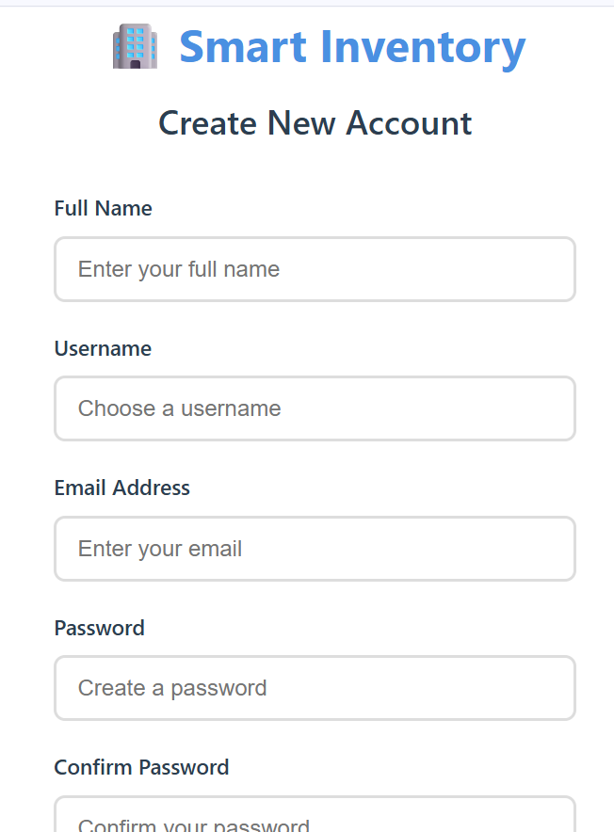
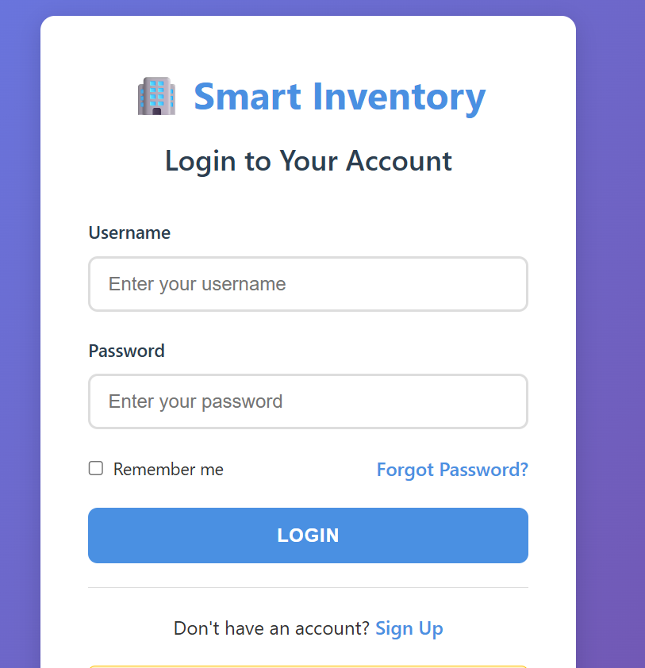
Outputs:

Slide 16
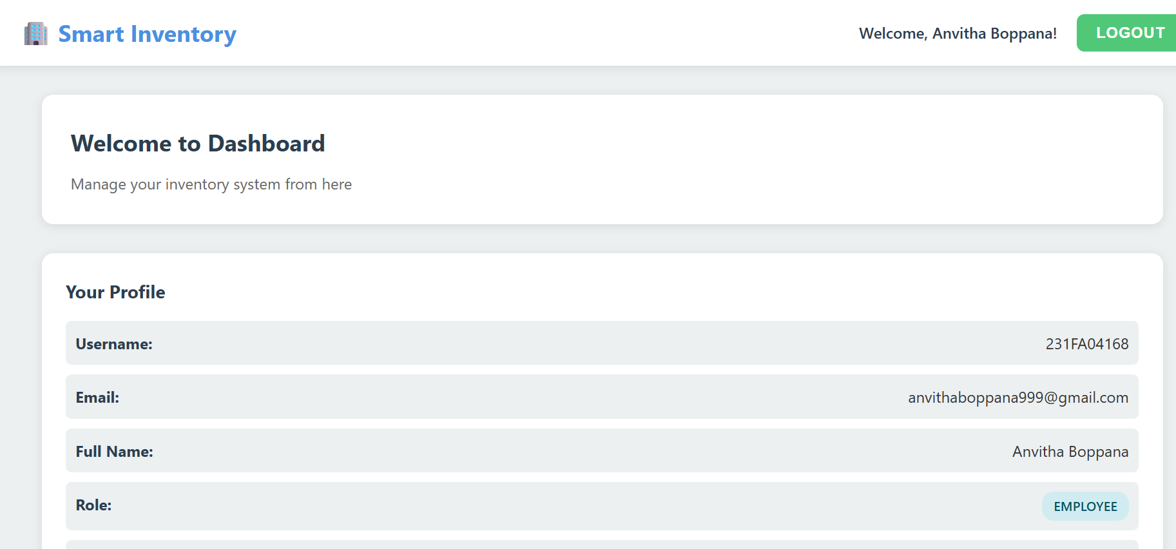
Outputs:

Slide 17
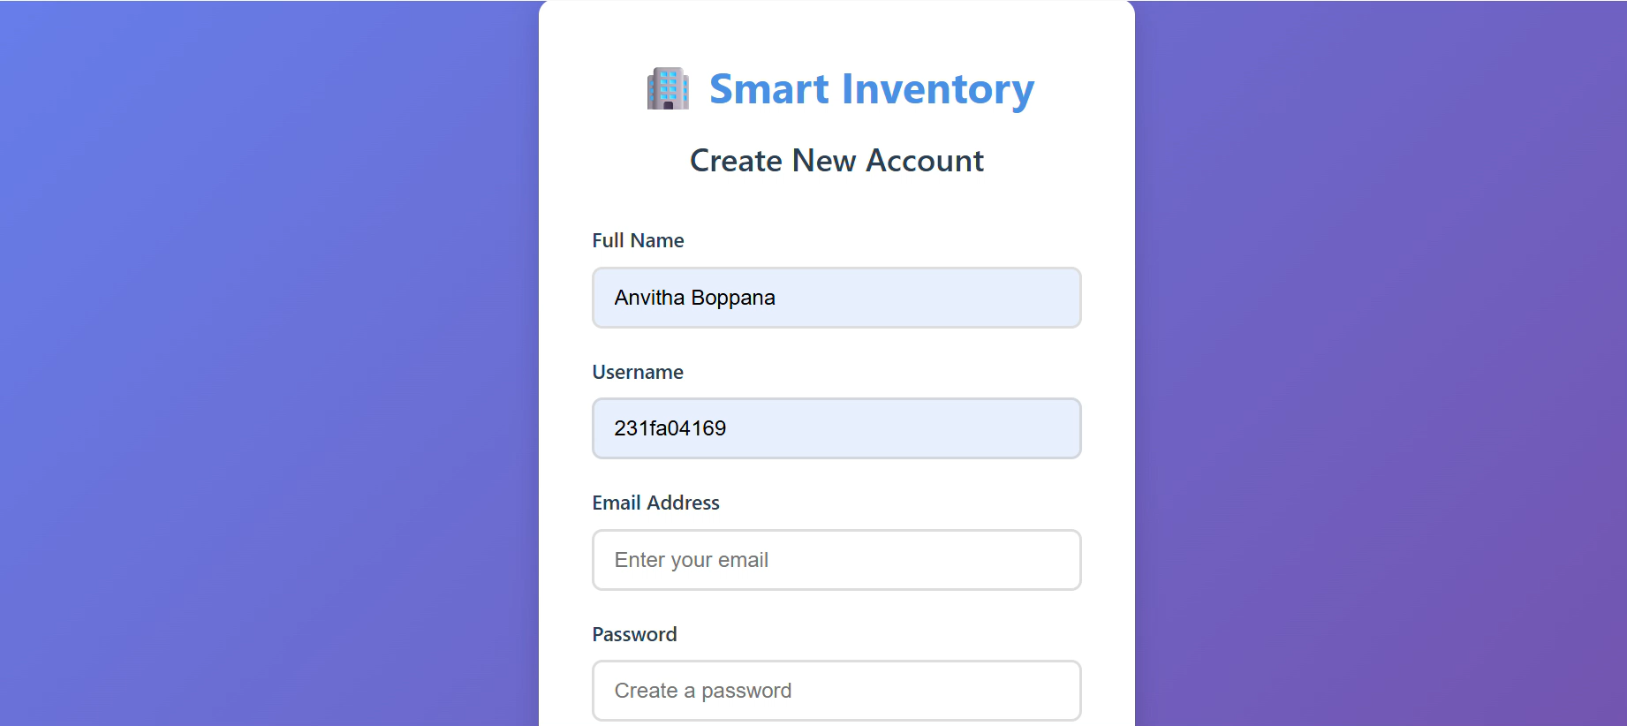
Demo Video:

Slide 18
Conclusion:
The Authentication and Authorization module keeps the Smart Inventory Management System secure. It makes sure only real users can log in and access the system based on their roles. This module also helps users reset passwords and log out safely. Overall, it protects the system from unauthorized access and keeps data safe.

Slide 19
References:
Spring Boot Official Documentation — https://spring.io/projects/spring-boot
MySQL Official Documentation — https://dev.mysql.com/doc/
MDN Web Docs: HTML, CSS, JavaScript – https://developer.mozilla.org/

